Slide 1
Customer retention
PROJECT BY
MIR AZHAR ALI KHAN

Slide 2
Problem Statement
Customer satisfaction has emerged as one of the most important factors that guarantee the success of online store; it has been posited as a key stimulant of purchase, repurchase intentions and customer loyalty. A comprehensive review of the literature, theories and models have been carried out to propose the models for customer activation and customer retention. Five major factors that contributed to the success of an e-commerce store have been identified as: service quality, system quality, information quality, trust and net benefit. The research furthermore investigated the factors that influence the online customers repeat purchase intention. The combination of both utilitarian value and hedonistic values are needed to affect the repeat purchase intention (loyalty) positively. The data is collected from the Indian online shoppers. Results indicate the e-retail success factors, which are very much critical for customer satisfaction.

Slide 3
UNDERSTANDING
If we analyze this dataset we will come to know what qualities should a Good E-Commerce website have in order for Customer Retention

Slide 4
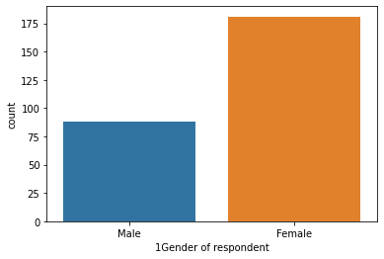
Analysis
The Shape of the data set is 260 rows and 71 Columns
There are more number of Female when Compared to Male in this Dataset below graph depicts the same

Slide 5
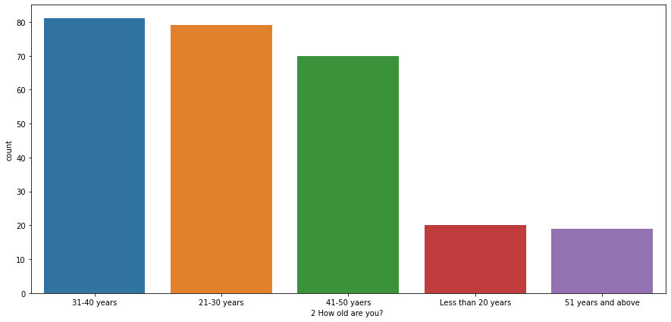
This graph give the clear idea that most of the
people in this dataset has the age in the range
of 31 to 40

Slide 6
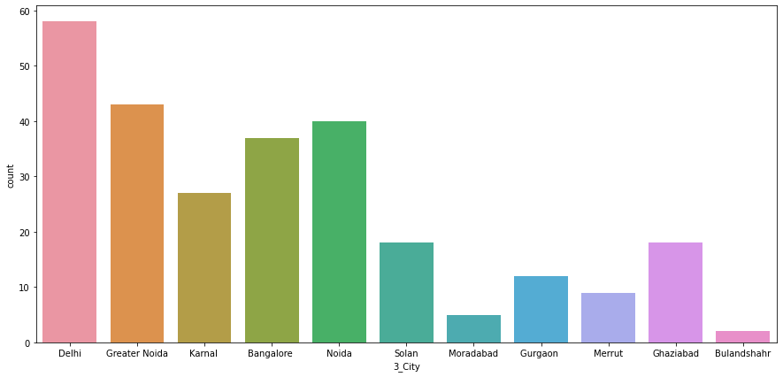
The below graph shows that most of the people
who gave their opinions are from Delhi

Slide 7
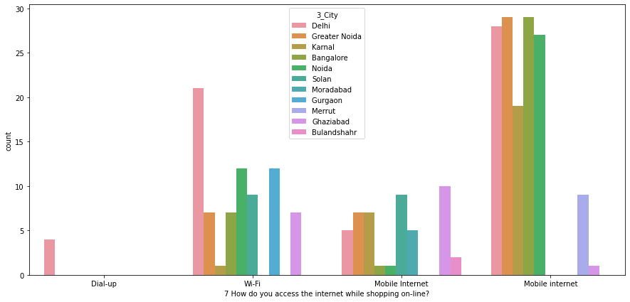
The below Graph shows that most of the people
uses Mobile internet of online Shopping and they
are mostly from Greater Noida

Slide 8
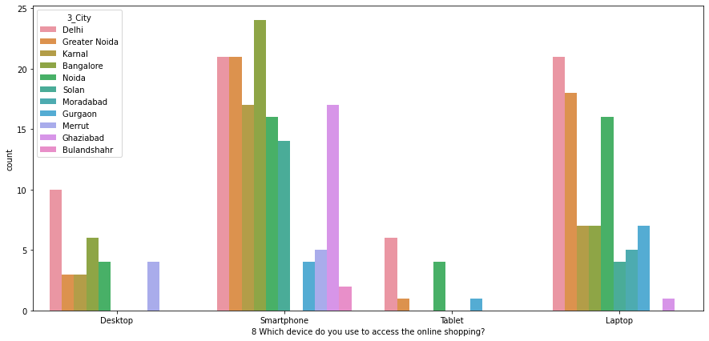
Most of people use Smartphone to access the
online shopping are mostly from Bangalore

Slide 9
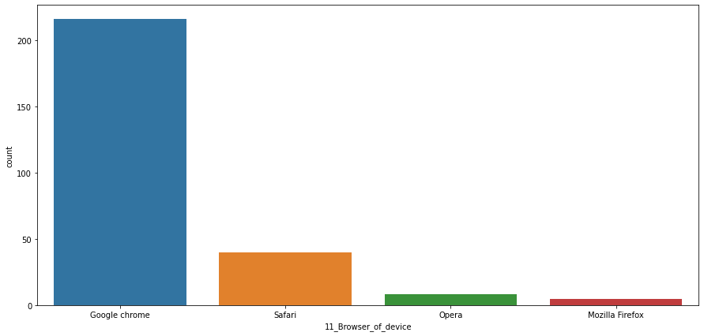
The below graph show that Majority of people use
Google Chrome to access the online shopping services

Slide 10
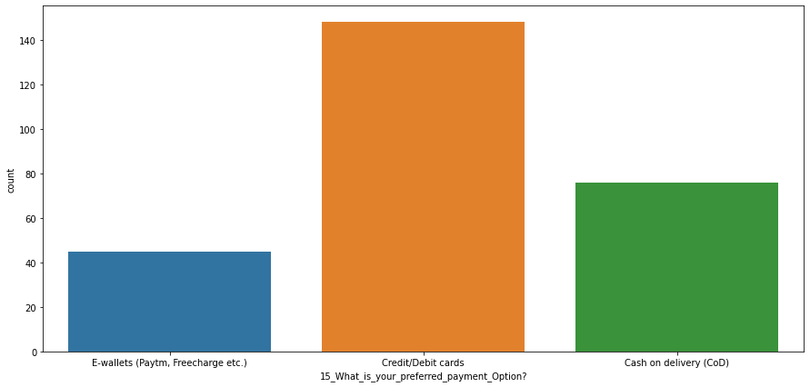
The below graph shows that most of the people uses
Credit/Debit Cards as their payment option

Slide 11
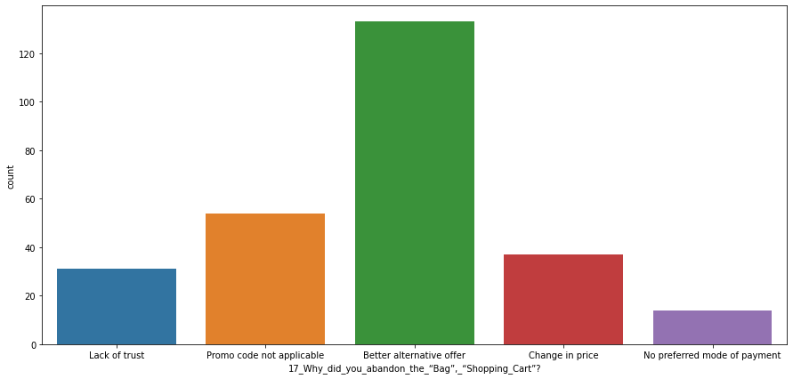
The below graph shows that most of the people
abandon the Bag or Shopping Cart
because they got better deal

Slide 12
The below graph shows that most of the people
abandon the Bag or Shopping Cart
because they got better deal

Slide 13
Conclusion
A Good for Example (Amazon. in ) website E-Commerce website should have the following qualities for customer retention:-
Easy to use website or application
Visual appealing web-page layout
Wild variety of product on offer
Complete, relevant description information of products
Fast loading website speed of website and application
Reliability of the website or application
Quickness to complete purchase
Availability of several payment options
Speedy order delivery
Privacy of customers information
Security of customer financial information
Perceived Trustworthiness
Presence of online assistance through multi-channel

Slide 14
Conclusion
A Good website E-Commerce website should not have the following :-
Longer time to get logged in (promotion, sales period)
Longer time in displaying graphics and photos (promotion, sales period)
Late declaration of price (promotion, sales period)
Longer page loading time (promotion, sales period)
Limited mode of payment on most products (promotion, sales period)
Longer delivery period.

